Slide 1

DESIGN AND IMPLEMENTATION OF PRAWN FEEDER MONITORING SYSTEM BASED ON IoT
PRESENTED BY
SAMIHA ANJUM 18S11D7005
Under the guidance of
Mr.Ravikumar (Ph.D)
DEPARTMENT OF ELECTRONICS AND COMMUNICATION ENGINEERING
MALLA REDDY INSTITUTE OF TECHNOLOGY AND SCIENCE

Slide 2
CONTENTS
Introduction
Objective
Block diagram
Supervisory control and data acquisition
Literature
References

Slide 3
INTRODUCTION
The feeder is designed to deliver a fixed amount of food at a particular time of day at regular intervals

Slide 4
OBJECTIVE
The feeder must deliver a fixed amount of food every 6 hours 4 times a day
The feeder must be easily programmed to change food quantities and feeding times
The feeder should be a standalone unit running off DC/AC power

Slide 5
BLOCK DIAGRAM
Current feeder
ARDUINO BOARD
LCD DISPLAY
(16x2)
POWER
SUPPLY
RTC
AC
MOTOR
RELAY
SWITCHES

Slide 6
BLOCK DIAGRAM
Upcoming feeder
Power sensor
&
Back up
LCD DISPLAY
(16 X 2)
Power supply
ARDUINO BOARD
RTC
GSM
AC
MOTOR
RELAY
Keypad
Load circuit

Slide 7
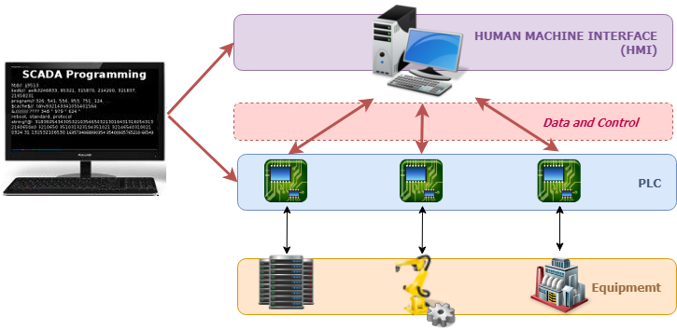
SUPERVISORY CONTROL AND DATA ACQUISITION

Slide 8
DATA ACQUISITION
Advantages
To acquire the necessary data , at correct time.
To monitor the complete plant operation to maintain on line safe operations.
To collect , summarise and store data for record purpose.

Slide 9
LITERATURE
SL.NO | Authors | Title of the paper | Remarks
1 | K.Krishna kishore, P.Vamsi Krishna, D.Srikanth | Automatic Feeding System for Aquaculture | Automatic Feeding system for Aquaculture is an innovative product in which aqua farmer can feed the aquatic creatures in their fisheries and different fishing habitats.
2 | Osueke, Olayanju, Onokwa | Design And Construction of an Automatic Fish Feeder Machine | An automated fish feeder was designed, fabricated and tested that automatically feed the feeder at a predetermined time.
3 | M.Z.H.Noor, A.K.Hussain,M.F.Saaid | The design and development of automatic fish feeder system using PIC microcontroller | The device developed combines mechanical and electrical system in controlling fish feeding activity. This device, basically consists of pellet storage, former, stand, DC motor and microcontroller.

Slide 10
CONT’D:
SL.NO | Authors | Title of the paper | Remarks
4 | DennisJ.Gaushell,HenryT.DarlingtonHenryT.Darlington | Supervisory Control and Data Acquisition | This paper provides an overview of the functions of SCADA and the fundamentals of operation of SCADA systems, including a brief description of the key man-machine interface.
5 | Musse Mohamud Ahmed, | New Supervisory Control and Data Acquisition (SCADA) Based Fault Isolation System for Low Voltage Distribution Systems | This paper proposes a new supervisory control and data acquisition (SCADA) based fault isolation system on the low voltage (415/240 V) distribution system.
6 | D.Pavitra,Ramjith Balakrishnan | IoT based monitoring and control system for home automation | The project proposes an efficient implementation for IoT (Internet of Things) used for monitoring and controlling the home appliances via World Wide Web.

Slide 11
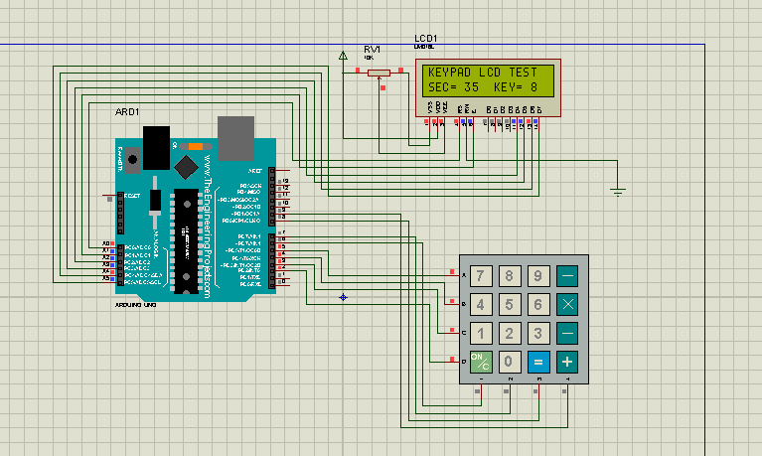
KEYPAD WITH LCD

Slide 12
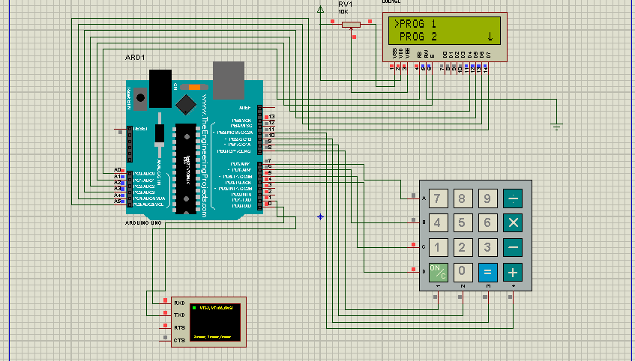
MENU BAR

Slide 13
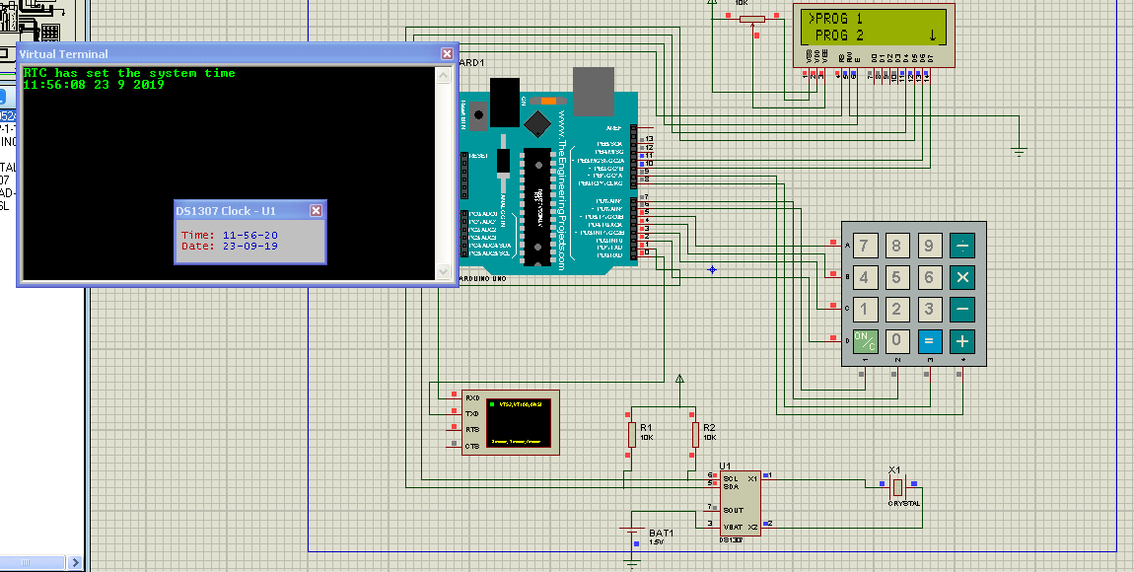
MENUBAR WITH RTC

Slide 14
REFERENCES
Prosanta Gope et al. 2016. BSN-Care: A Secure IoT- based Modern Healthcare System Using Body Sensor Network. IEEE Sensors Journal. 16(5): 1368-1376.
Tzonelih Hwang et al. 2016. Untraceable Sensor Movement in Distributed IoT Infrastructure. IEEE Sensors Journal. 15(9): 5340-5348.
Tae-Yoon Kim et al. 2015. Multi-Hop WBAN Construction for Healthcare IoT Systems. IEEE Platform Technology and Service (PlatCon),International Conference. pp. 27-28.
Atzori Luigi, Antonio Iera, Giacomo Morabito, "The internet of things: A survey", Computer networks, vol. 54, no. 15, pp. 2787-2805, 2010.
IEEE Tutorial Course-Fundamentals of Supervisory Control Systems, IEEE Power Society, PuM. 81 EHO 1883 PWR.
ICP DAS, 7188E/843X/844X/883X/884X TCP/IP Library User’s Manual, Ver. 1.0 Copyright 2002.

Slide 15
Thank you

